Slide 1
Civilian PDT HHG Tax Debts
AFIMSC/FMFK
20 Feb 2024

Slide 2
Purpose
Employee PCS Traveler Education on Tax Cut & Jobs Acts effects on Civilian PCS Reimbursements

Slide 3
Overview
Tax Cut and Jobs Act (TCJA)
Civilian Entitlements
Mandatory Taxes
Impact on Taxes for Government HHG Shipment
Examples
Withholding Tax Advance (WTA)
Relocation Income Tax Allowance (RITA)
Resources/Points of Contact

Slide 4
What is the TCJA?
The Tax Cut and Jobs Act was implemented on 1 January 2018.
This Act changed the way taxable income is calculated and reduced the tax rates on that income.
Benefits of the TCJA was that standard deductions were almost doubled. Creating less of a tax burden on most Americans.
The impacts to Civilian Employees who travel on PCS orders is an increased tax liability.
All in-kind benefits paid to a commercial vendor on behalf of the traveler are now taxed. This is a change from 2017 and prior.
Examples include HHG shipments, Centrally Billed Airfare, etc.

Slide 5
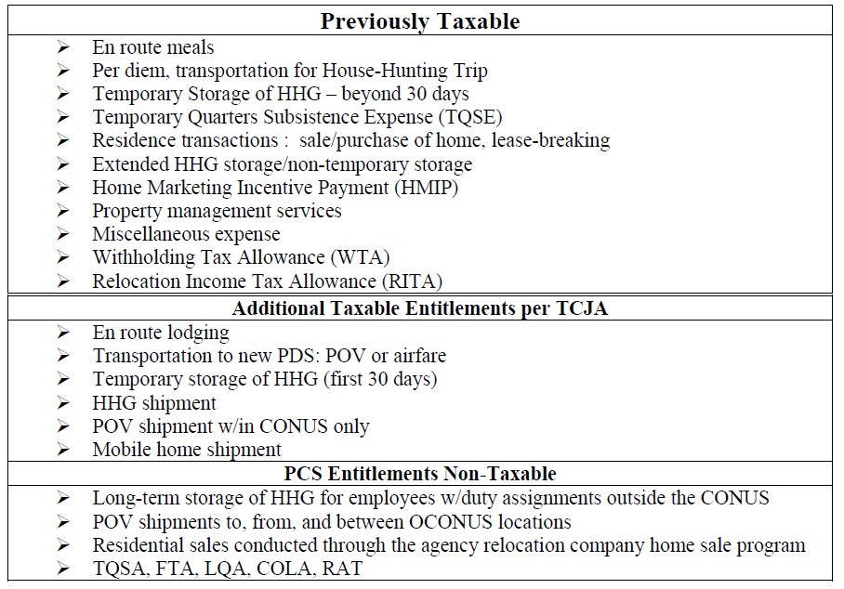
Tax Changes

Slide 6
Mandatory Tax Calculation
FERS Tax Computation
FITW 22%
FICA 7.65%
Social Security 6.2%
Medicare 1.45%
Total taxable amount 29.65%
If WTA is elected, it is calculated at 28.20512%.
This is due to the fact that WTA is also taxable and has to cover the tax of the entitlement as well as the tax on the WTA itself.
Exception – CSRS retirement does not calculate Social Security (6.2%).
This is a retirement option that only available to employees hired prior to 1 January 1987.

Slide 7
Tax Debt on Gov Household Goods Shipment
Government Household Goods Shipment cost is taxable. (TCJA’s biggest change)
The Vender sends the invoice to Transcom. Transcom pays the invoice within 30 days.
Transcom sends the Air Force a listing of paid invoices for the cost of the HHG shipment.
Travel Pay Processing Ellsworth then computes the tax liability for the total cost of the HHG Shipment.
Once Travel Pay Processing Ellsworth establishes the debt in RTS for the taxes.
Debt notification will be physically mailed to the employee, using the address on file from the most recent PDT 1351-2 provided to TPPE.
A copy of the Transcom list of vender charges is provided to support the tax debt.
A copy of the TJCA pamphlet is also provided to explain the process to the employee.
Employee has the option of paying the debt in full or establishing a repayment plan.

Slide 8
Tax Debt Examples
In this example the employee was charged and total of $12,956.13 for their Gov HHG shipment.
FITW 22%
FICA 7.65%
Social Security 6.2%
Medicare 1.45%
Total taxable amount 29.65%
$12,956.13 x 22% = $2,850.35
$12,956.13 x 6.2% = $803.28
$12,956.13 x 1.45% = $187.86
Total tax = $3,841.49
Copy of the Transcom Invoice

Slide 9
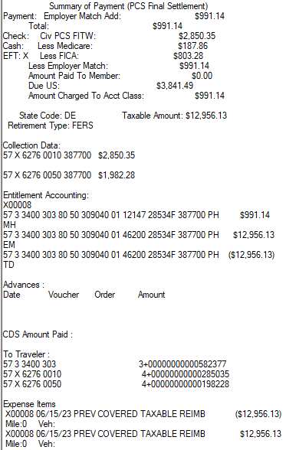
Tax Debt Examples
How it looks on the RTS Payment Summary
Total HHG shipment cost $12,956.13
No WTA was elected
Total taxable income $12,956.13
Debt “Due US” $3,841.49

Slide 10
Withholding Tax Allowance (WTA)
To ease the burden of the tax debt, WTA is an option.
WTA is a taxable entitlement that covers the 22% FITW on the HHG debt as well as itself.
Withholding Tax Allowance is considered an advance and must be reconciled with a RITA the following year.
If the employee elects WTA on their PDT voucher, TPPE will automatically apply the WTA to the tax debt. This will not eliminate the debt but reduce it.
If the employee does not elect WTA on their PDT voucher, TPPE will not apply the WTA to the tax debt.

Slide 11
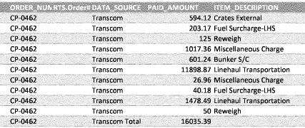
Example of impact of WTA
In this example the employee was charged a total of $16,035.39 for their Gov HHG shipment. The employee elected WTA on their PDT claim.
FITW 22% - * if WTA is elected, it is also taxed at 28.20512% instead of 22%.
FICA 7.65%
Social Security 6.2%
Medicare 1.45%
$16,035.39 x 28.20512% = $4,522.80
$4,522.80 is the WTA (advance)
$16,035.39 + $4522.80 = $20,558.19
Both the HHG & WTA are now taxable income.
$20,558.19 x 22% = $4,522.80
$20,558.19 x 6.2% = $1,274.61
$20,558.19 x 1.45% = $298.09
Total $6,095.50 – $4522.80 (WTA) = $1,572.70
Total tax debt = $1,572.70

Slide 12
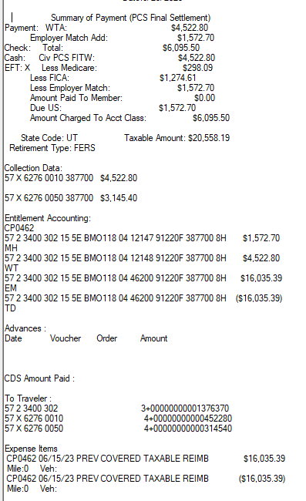
Example of impact of WTA
How it looks in RTS
Total HHG shipment cost $16,035.39
WTA $4,522.80 (advance)
Total taxable income $20,558.19
Debt “Due US” $1,572.70

Slide 13
Things to Remember
Tax Debts cannot be waived or remitted.
Debts cannot be suspended.
Payment plan options are listed in the debt notification letter.
There is a silver lining: employees will be able to file a RITA claim in the following year once their federal tax return is complete. This will help offset the taxes.
If WTA is elected, a RITA must be filed, or a debt will be established.
It is possible that Transcom will submit additional charges and the employee will have more than one HHG tax debt.
Questions or concerns over actual charged Transcom amounts need to be addressed with the employee’s TMO office.
Debts are established when Transcom sends the lists; this could be many months after the HHG were shipped. Rare, but we have seen some take over a year to get to TPPE.

Slide 14
Air Force Public Affairs Release

Slide 15
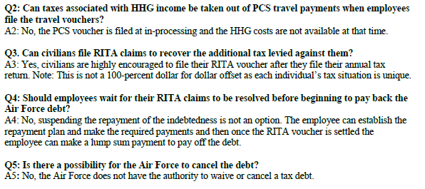
AF PA Release FAQs
* Chart referenced is on slide 5.

Slide 16
Questions?
If you have questions, please contact your local finance office for assistance.

